Slide 1
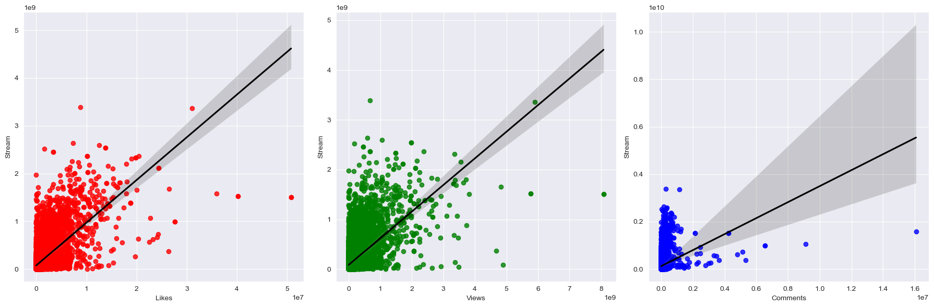
Of the 15 variables - Likes, Views and Comments had the highest correlation when it came to Streams. Likes had a correlation of 0.65, Views had a correlation of 0.60 and Comments had a correlation of 0.27.
Spotify vs YouTube – Executive Presentation
Date: July 18th, 2023
Presenter: Harjinder Singh

Slide 2
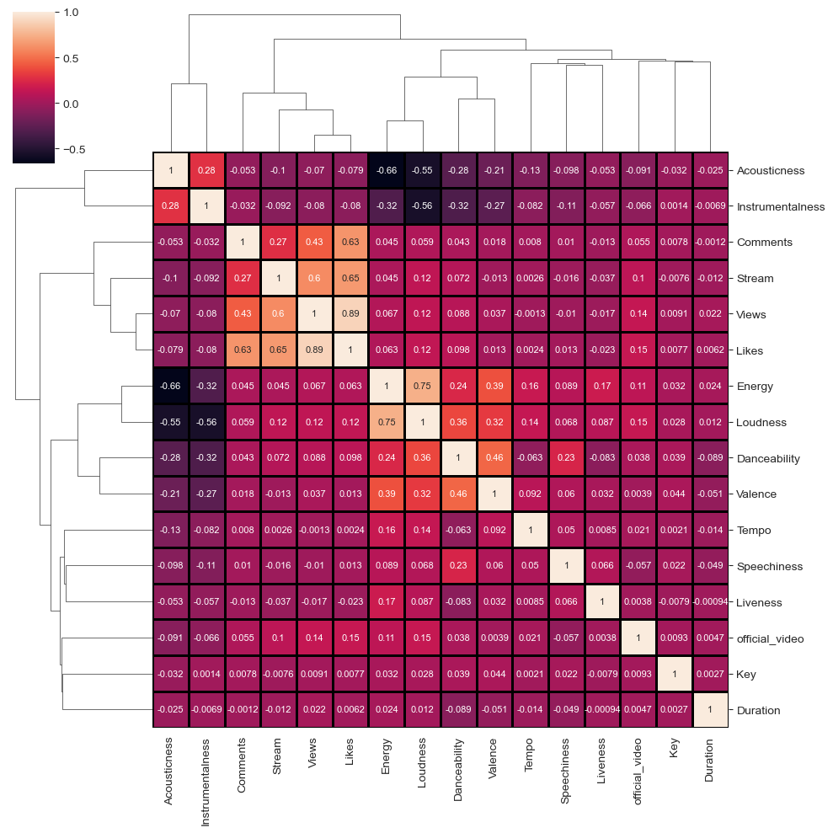
Based upon the cluster map, you can see there are several areas of correlation here:
Once again the top 3 variables that are correlated with Stream are Likes, Views and Comments.
Another cluster of correlations that appeared were within the Likes, Views and Comments

Slide 3
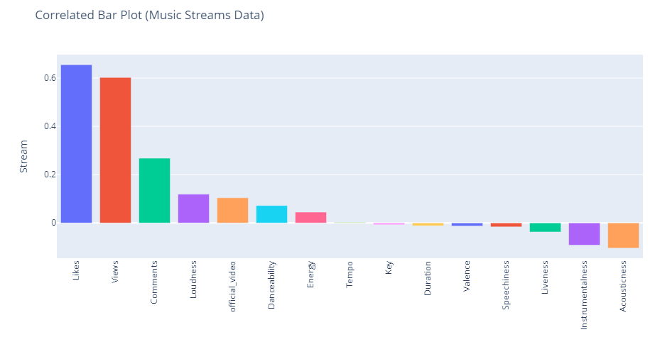
Of the 15 variables - Likes, Views and Comments had the highest correlation when it came to Streams. Likes had a correlation of 0.65, Views had a correlation of 0.60 and Comments had a correlation of 0.27.

Slide 4
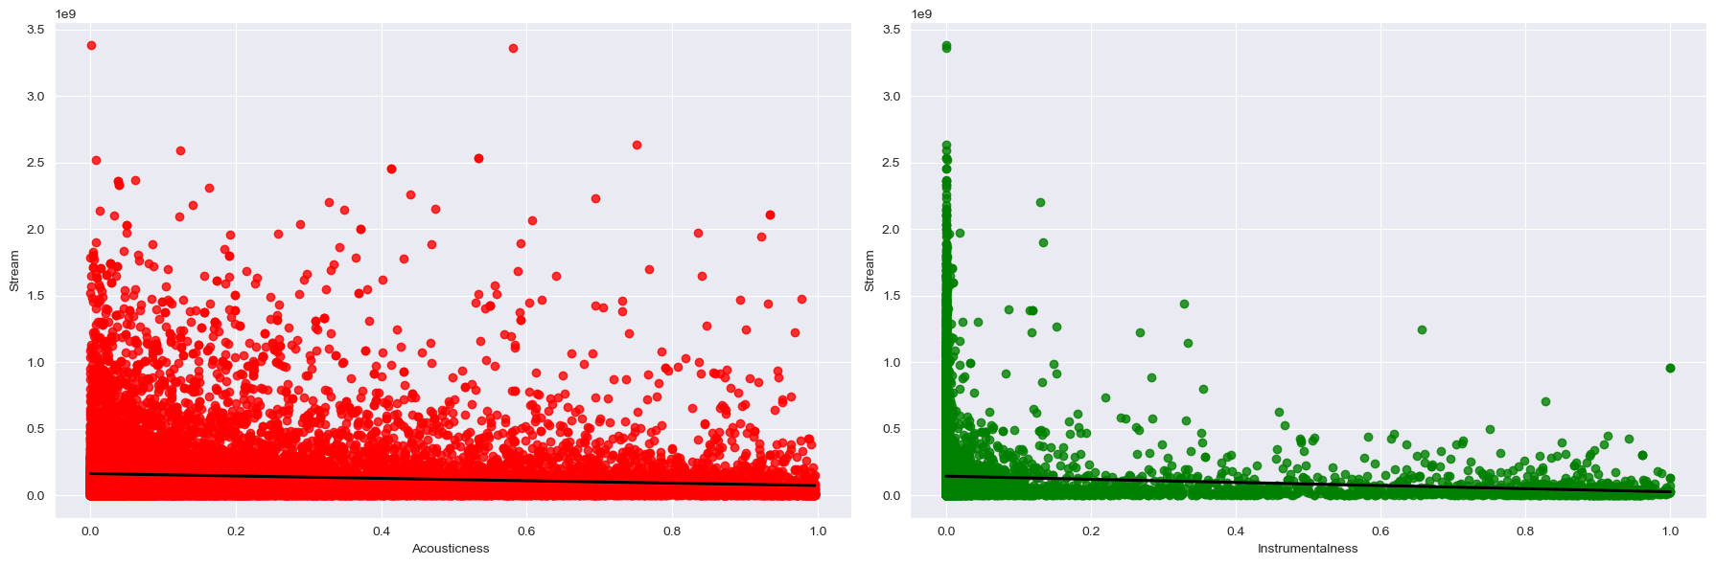
Of the 15 variables - Acousticness and Instrumentalness had the lowest correlation when it came to Streams. Acousticness had a weak correlation of -0.09 and Instrumentalness had a weak correlation of -0.10.

Slide 5
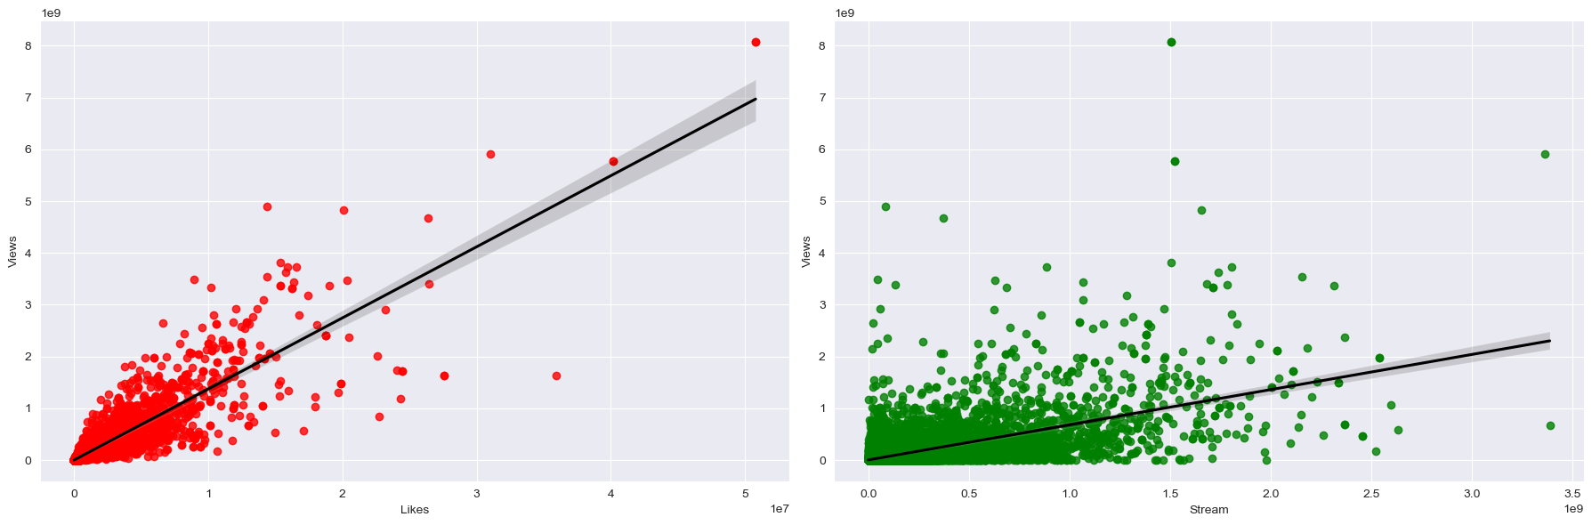
Another area that had strong correlation with each other was when the Likes went up, Views also went up correlation of 0.89. Then when the Stream went up, the Views also went up correlation of 0.60.

Slide 6
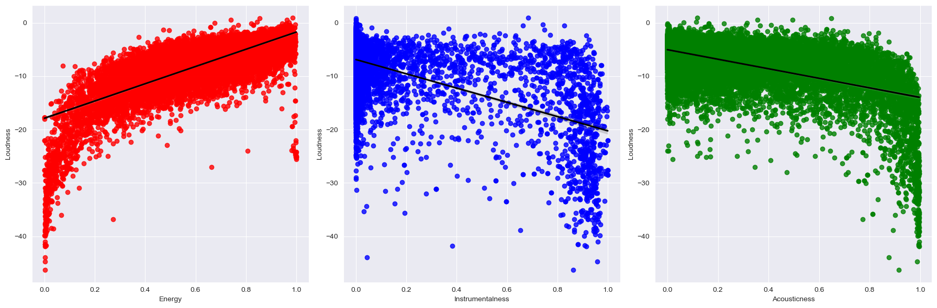
Energy, Instrumentalness and Acousticness showed correlation to Loudness. As the Energy of a song went up, the Loudness of the song also went up. On the contrast, as the Instrumentalness and Acousticness went up the Loudness of the song went down.

Slide 7
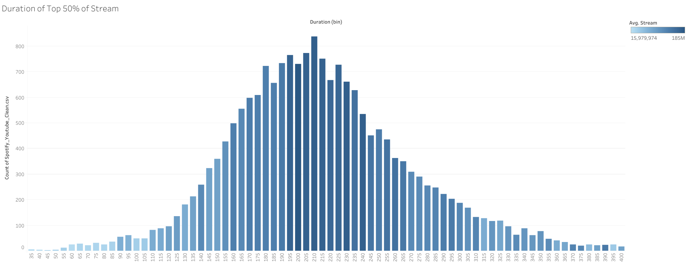
This histogram shows only the top 50% of songs based on their stream counts and only songs with a 'Duration' value between 0 and 400 (seconds). The distribution of song durations exhibits a standard bell curve pattern, indicating that a majority of songs fall within the average duration range with fewer songs at the extreme ends of the duration spectrum.

Slide 8
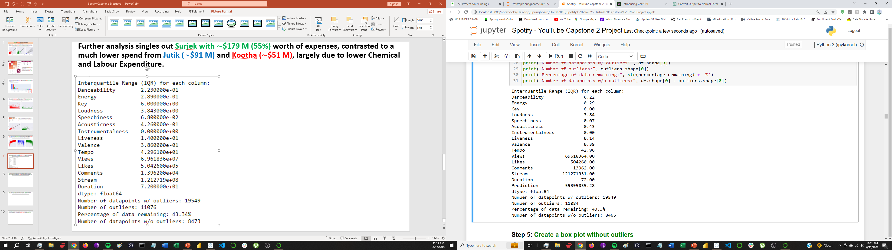
The data has a high number of outliers, resulting in a smaller dataset with only 43.3% of the original data remaining for analysis without outliers.

Slide 9
Concluding our analysis, Likes, Views and Comments had the highest correlation when it came to Streams. Likes had a correlation of 0.65, Views had a correlation of 0.60 and Comments had a correlation of 0.27.

